Slide 1

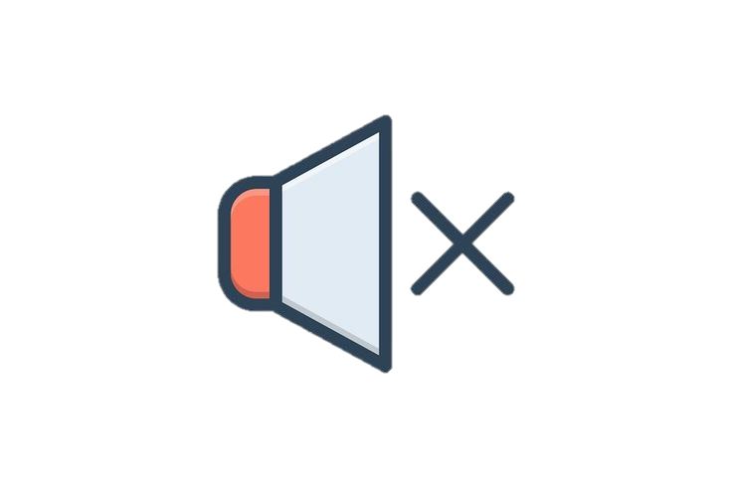
Silent Conversations
Sign Language Recognition in Deafness and Hearing Loss Using Artificial Intelligence
2023 - 2024
1

Slide 2
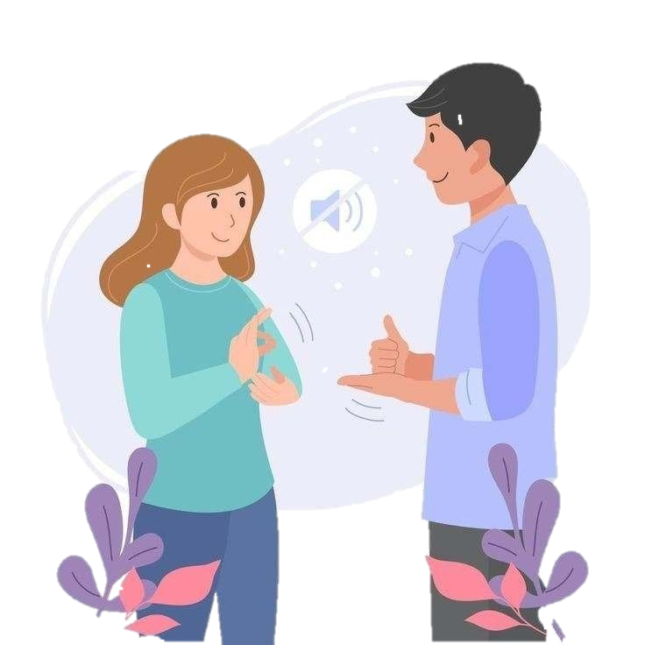

Supervisors
Dr.Ahmed Abdelraheem
Lecturer, Department of Information Technology at EELU
Eng.Aya Magdy Youssef
Teacher Assistant, Department of Information Technology at EELU
2

Slide 3
Team Members
Sama Alaa
Amira Hashem
2001081
2000739
Amira Ahmed
Zyad Medhat
Rawan Hamada
Sara Ahmed
Mona Hassan
2001213
2001021
2001083
2000987
2000769
3

Slide 4
01
03
04
05
06
07
Introduction →
02
Background→
Agenda
Literature Review (Related Work) →
System Methodology →
Prototype, Tools, and Technologies + Framework →
Project scope→
Conclusion →
4

Slide 5
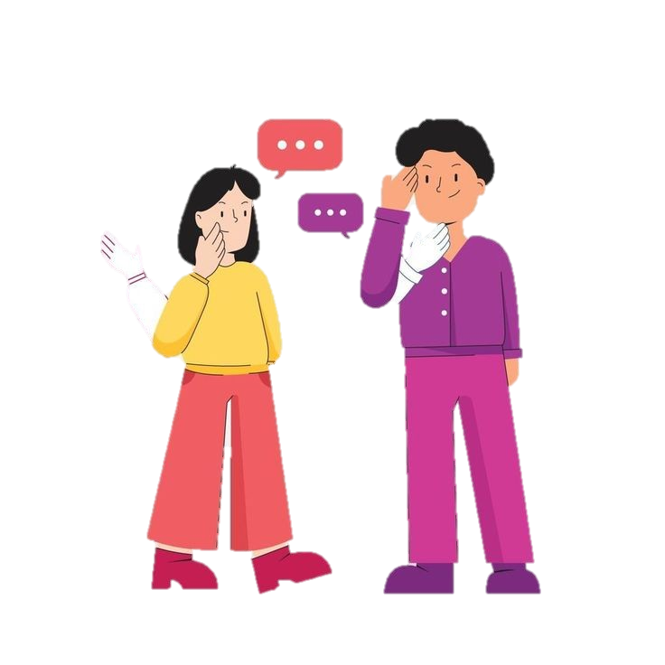
01
Introduction
5

Slide 6
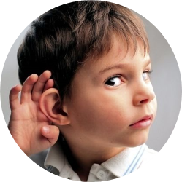
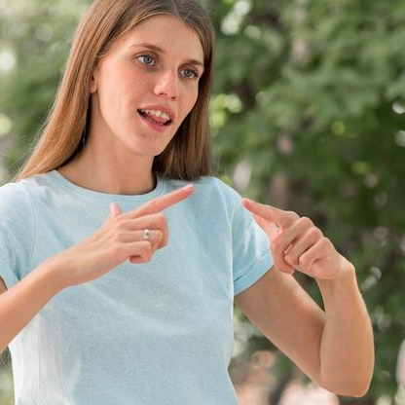
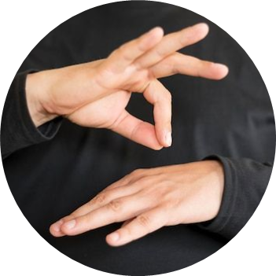
Deaf and hearing-impaired people face many challenges and problems in their daily lives. They suffer from difficulty communicating with people who do not master sign language.
It is difficult for them to exchange thoughts, feelings, and daily needs. They may feel isolated and cut off from society. This social isolation can negatively affect mental health. And emotional to them.
6

Slide 7


Therefore, the idea of our project is to create a mobile application that is a silent conversation to learn sign language for individuals who suffer from deafness or hearing loss, to bridge the communication gap between the deaf community and the hearing world by enabling simultaneous translation of sign language gestures using all algorithms and computer vision techniques.
7

Slide 8

02
Background
8

Slide 9
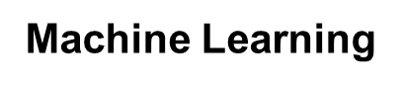
Clastering
Unsupervised
Regression
Classification
ML
Machine Learning
Reinforcement
Supervised
9

Slide 10
Deep Learning
Algorithms
DL
CNN
Is a new field of
research that deals with finding algorithms that allow the machine to learn on its own.
techniques enable this automatic learning through the absorption of huge amounts of unstructured data such as text, images or video.
Yollo v8
10

Slide 11
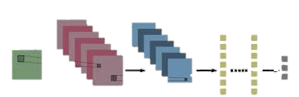
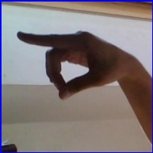
Convolutional Neural Networks - CNN Algorithm
Conv Layer
Pooling Layer
Fully connected
Input layer
Output Layer
We will use the CNN model, which is a type of neural network that is used in computer vision, and it is one of the very important fields in deep learning. It processes and recognizes data (images and videos). It is designed to deal with this type of two- and three-dimensional data and extract information from it. This is done through number of layers that make up the model, which enable it to better recognize images and classify them correctly. It can deal with a huge amount of data. The more numerous and diverse data is available, the better its work.
11

Slide 12
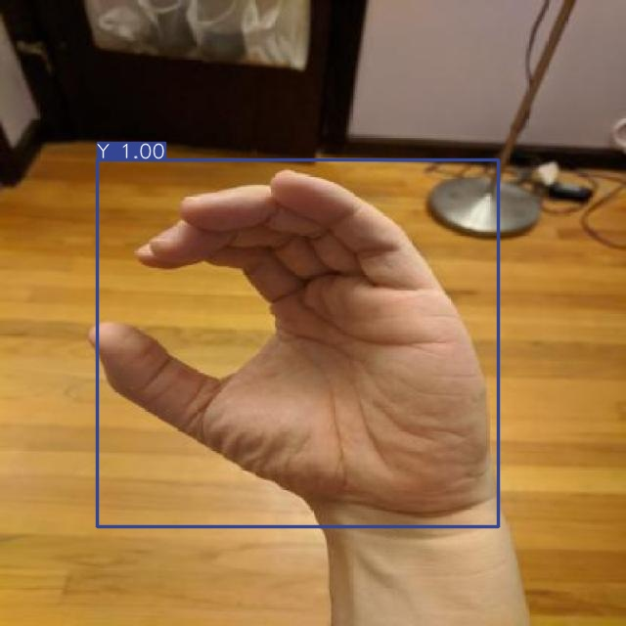
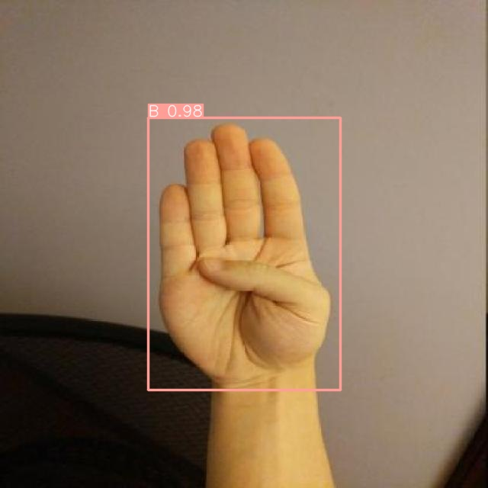
Yolo v8 Algorithm
is an object detection model that uses deep neural networks. YOLO takes an innovative approach to the object detection process, dividing the image into a grid of cells or several square sections, such as (3*3), and each square examines the image to determine whether it contains the required part or not and then analysing the image as a whole in one go, making it more efficient and faster than traditional models that divide the image into small sectors and analyse them separately
12

Slide 13
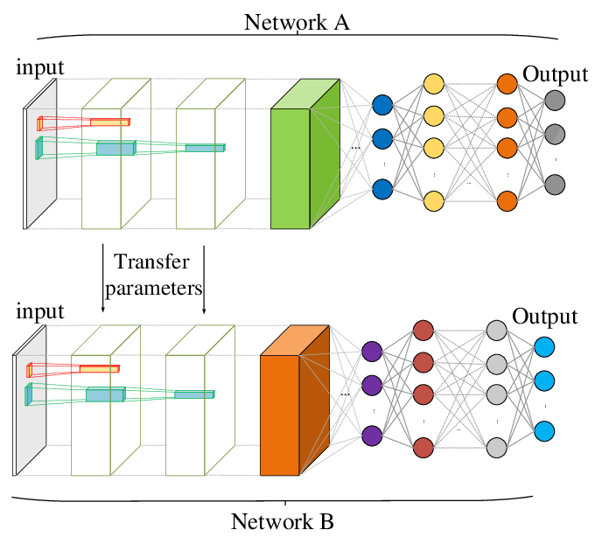
Pre-trained Models
Pre – train model
CNN new task
A pretrained model is a deep learning model someone else built that’s trained on large datasets to accomplish a specific task and solve some problem , and it can be used as is or customized to suit application requirements across multiple industries.
13

Slide 14
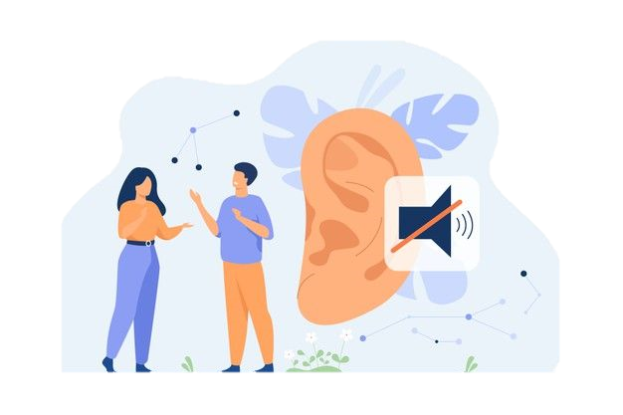
03
Literature Review
(Related Work)
14

Slide 15
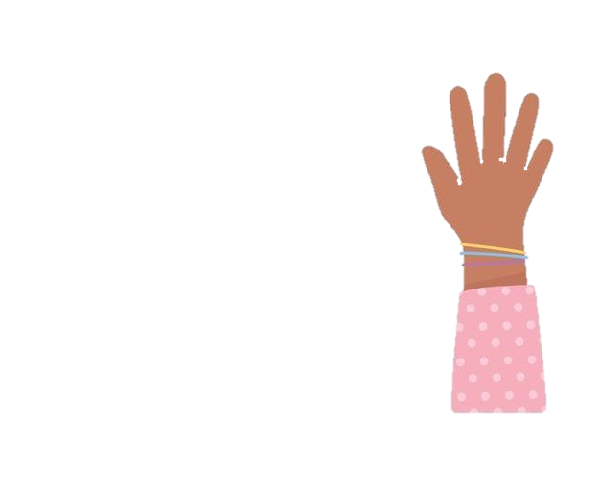
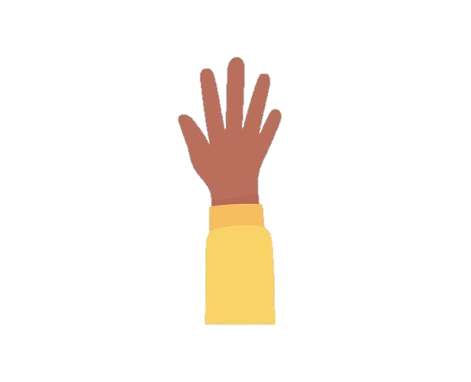
 | Name | Year | Algorithm | Dataset | Accuracy
1 | A New Benchmark on American Sign Language Recognition using Convolutional Neural Network | 2019 | CNN | Synthetic ASL Alphabet | 99.96%
2 | Sign Language Alphabet Recognition Using Convolution Neural Network | 2021 | CNN | Sign Language (ENG Alphabet) | 99.63%
3 | CNN Model for American Sign Language Recognition | 2020 | CNN | Sign Language MNIST | 99.30%
4 | Hyper tuned Deep Convolutional Neural Network for Sign Language Recognition | 2023 | CNN | Sign Language MNIST | 99%
15

Slide 16
 | Name | Year | Algorithm | Dataset | Accuracy
5 | Sign Language to Sentence Interpreter Using Convolutional Neural Network in Real Time | 2022 | CNN | ASL(American Sign Language) Alphabet Dataset | 98.7%
6 | Classification of Sign Language Characters by Applying a Deep Convolutional Neural Network | 2020 | CNN | Sign Language MNIST | 97.62%
7 | Sign language recognition system for communicating to people with disabilities | 2023 | CNN | ASL Handsign Dataset (Grayscale & Thresholder) | 96.3%
16

Slide 17
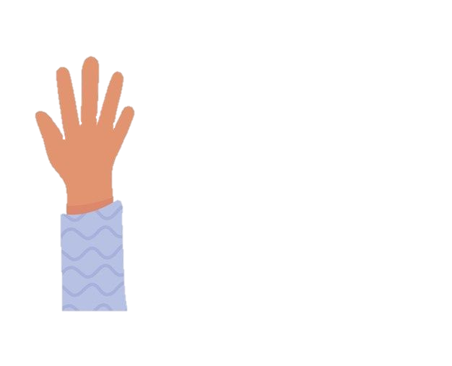
 | Name | Year | Algorithm | Dataset | Accuracy
8 | A Translator for Sign Language to Multilingual Text and Speech | 2023 | CNN | Beginner to Intermediate NLP Tutorial | 95.20%
9 | Reconstruction of CNN for Sign Language Recognition | 2020 | CNN | ASL Fingerspelling Recognition w/ TensorFlow | 92.21%
10 | Arabic Sign Language Recognition and Generating Arabic Speech Using Convolutional Neural Network | 2020 | CNN | RGB Arabic Alphabets Sign Language Dataset | 90%
17

Slide 18
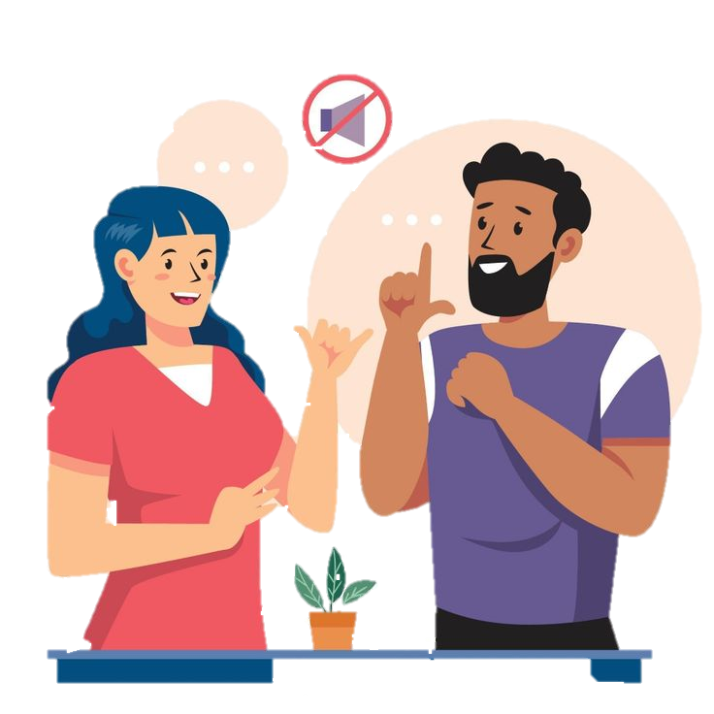
04
System Methodology
18

Slide 19
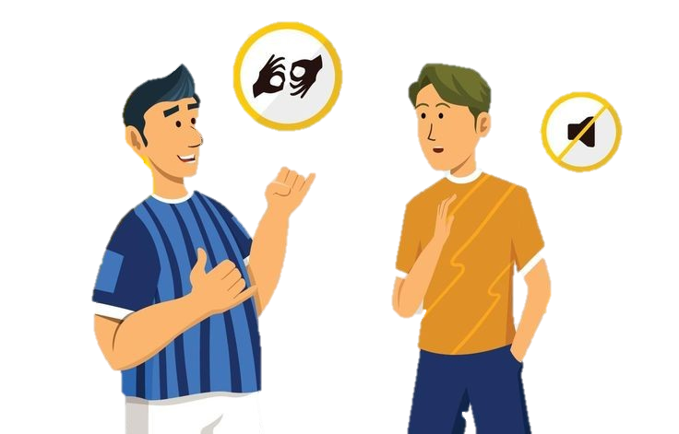
Steps of creating a CNN model
01 Data Collection
05 Model Training
09
Integrate the model into an application
02 Data Splitting
06 Model Evaluation
03
Data Preprocessing
07 Improve Performance
04
CNN Model
08 Final Model Test
19

Slide 20

Data collectionIt
collects a large set of classified data that contains images and videos of sign language and then loads it.
Step 01
Data splitting
The data will be divided into a group for training and a group for testing, and the division depends on its size.
Step 02
Data Preprocessing
In this step, we need to handle missing Values, Outlier Detection and Handling, Data normalization, encoding categories, reduce dimensions(resize), remove redundancy, data augmentation and others, as required by the data, to make it more homogeneous.
Step 03
20

Slide 21
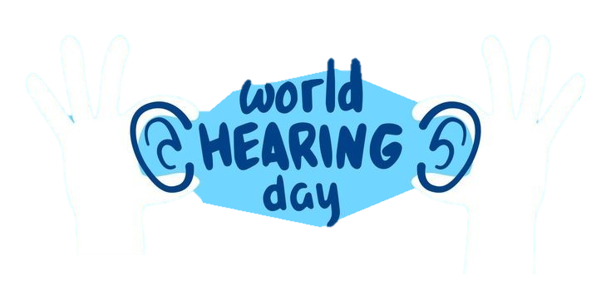

CNN model
Here, the CNN model is built so that it consists of number of layers that are appropriate for the model to analyze data (images and videos), and it consists of number of hyperparameters that are set and modified until we achieve the highest accuracy of the model.
Step 04
Step 05
Model training Use the training set to train the model it and adjust the hyperparameters based on the model’s performance on the test set
Model evaluation
In it, the trained model is applied to the test data, and its accuracy is measured to determine the extent to which it works correctly.
Step 06
21

Slide 22
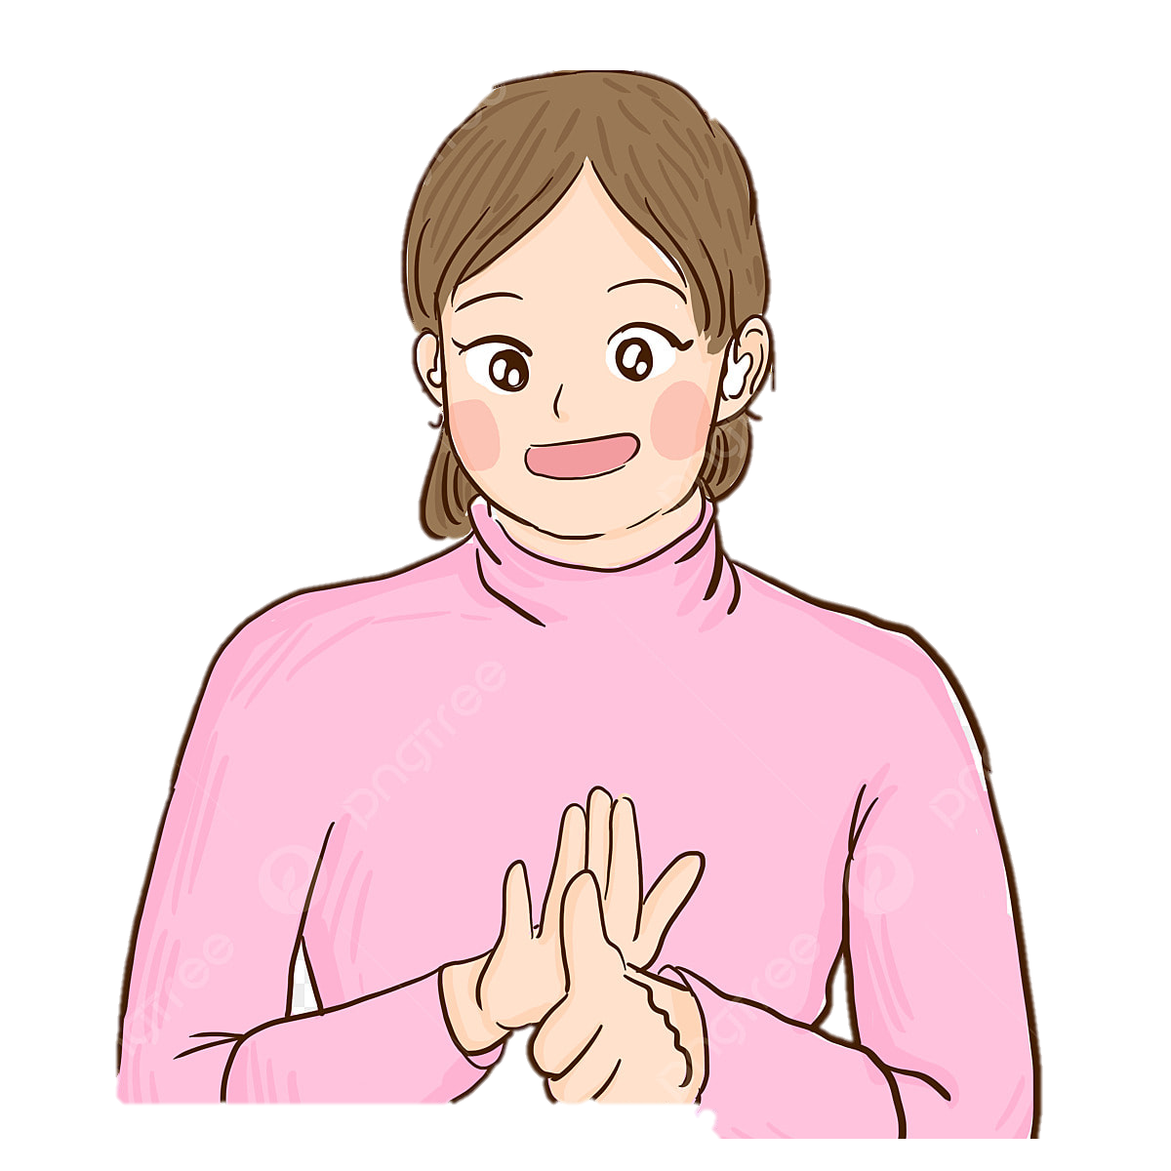
Improve performance The hyperparameters are adjusted if the accuracy of the model is low and there is an Overfitting or Bias until we reach the highest accuracy.
Step 07
Step 08
Final model test
Test the model on new data to ensure its ability to recognize sign language and function correctly
Integrate the model into an application
After verifying the model's performance and accuracy, we integrate it with a mobile application.
Step 09
22

Slide 23
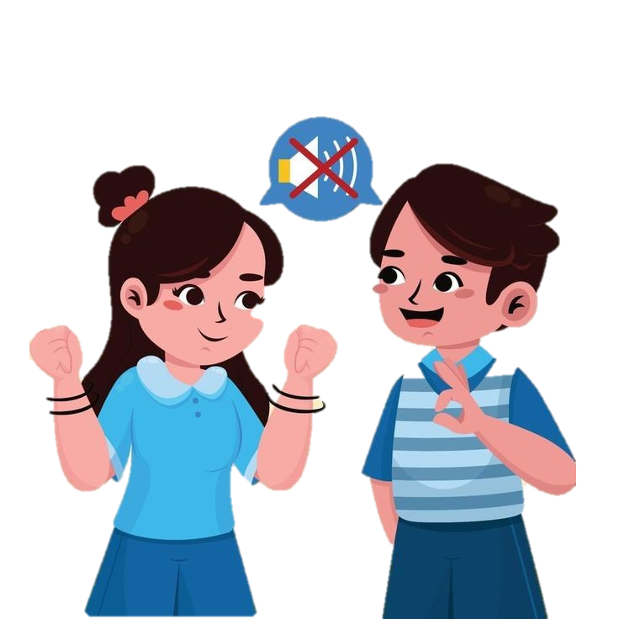

Dataset of
English
Arabic
Spanish
India
23

Slide 24
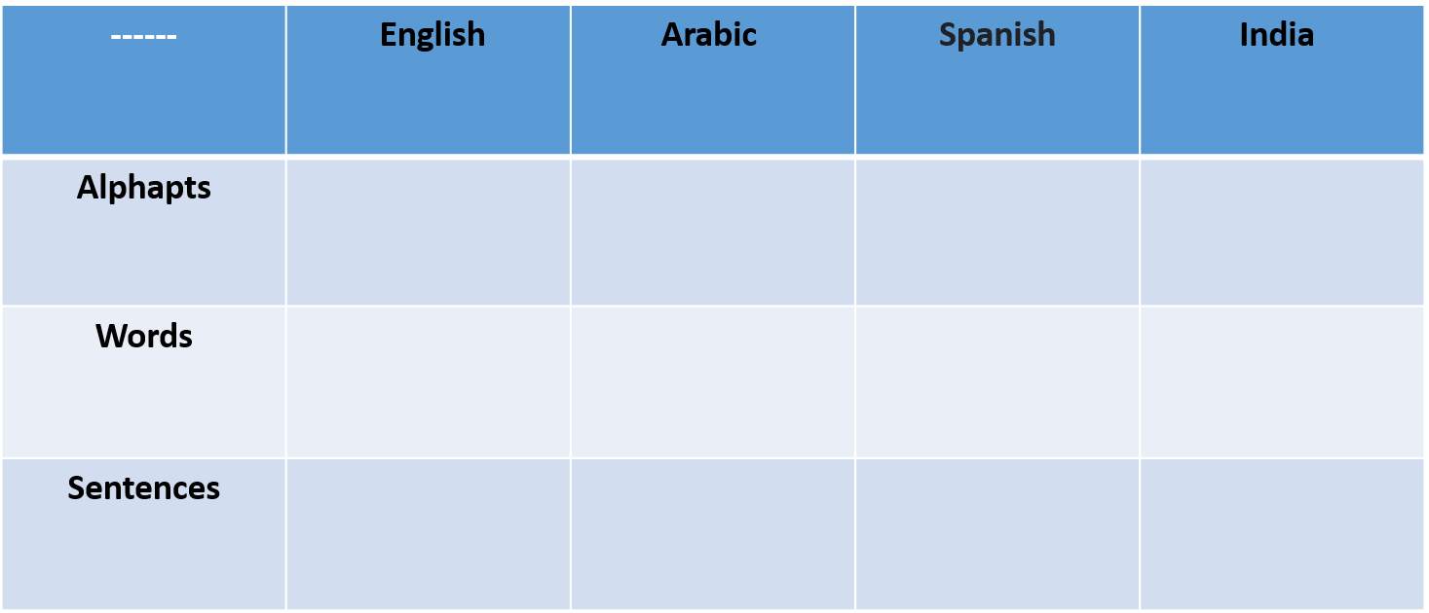
The Dataset ( Done or not )
24

Slide 25
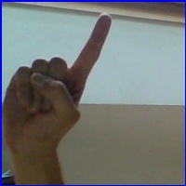
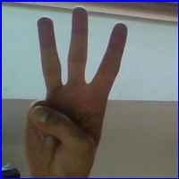
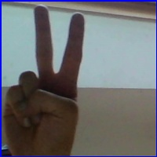
American Alphabet dataset
25

Slide 26
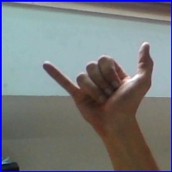
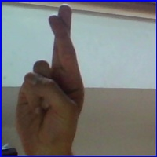
The dataset is About:
The dataset is a collection of images of alphabets from the American Sign Language, separated in 29 folders of 26 are for the letters A-Z and 3 classes for SPACE, DELETE and NOTHING which are 200x200 pixels.
26

Slide 27
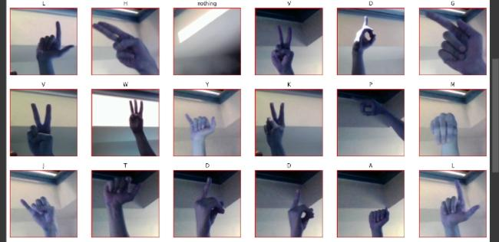
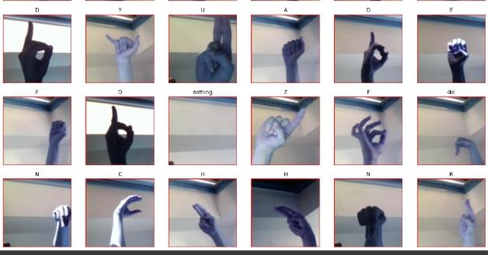
samples from the dataset
27

Slide 28
Split Dataset
X_Train
Test
X-validation
87000 items
28 items
Y_Train
Split=20:80%
shuffle=True, random_state=100
Y-validation
87000 items
28

Slide 29
Preprocessing
Normalization (/255)
Scaling
Resizing (100*100)
29

Slide 30
Create a CNN model on the Dataset
Layer type | Layer type Description | Size
Input Layer Conv 1 Conv 2 Conv 3 Conv 4 | Input Image Convolutional ReLU MaxPooling Convolutional ReLU MaxPooling Convolutional ReLU MaxPooling Convolutional ReLU MaxPooling | 3×100×100 32 kernel, 3x3 Window size 2×2 64 kernel, 5x5 Window size 2×2 128 kernel, 5x5 Window size 2×2 256 kernel, 3x3 Window size 2×2
30

Slide 31
Layer type | Layer type Description | Size
Flatten Fully Connected Layer1 Fully Connected Layer2 Fully Connected Layer3 Output Layer | Flatten Dense ReLU Dense ReLU Dense ReLU Dense SoftMax | 512 265 182 29
31

Slide 32
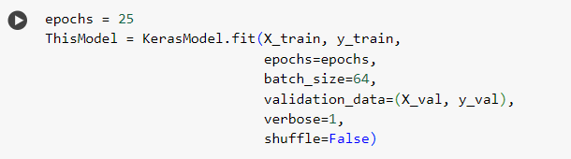
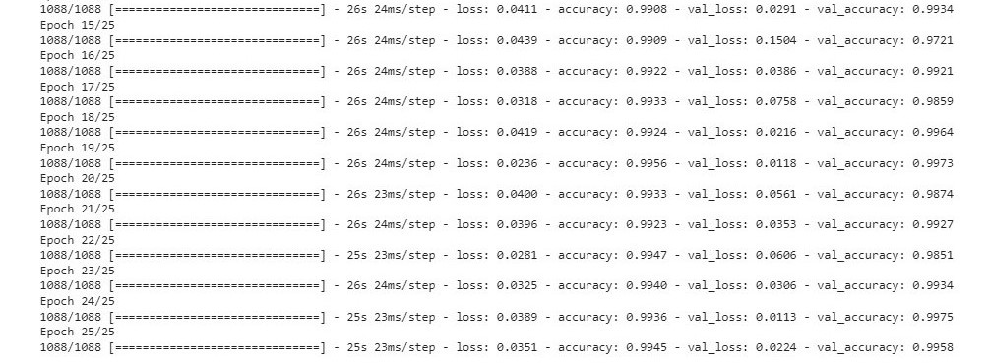
Epochs’ Number
1
2
32

Slide 33
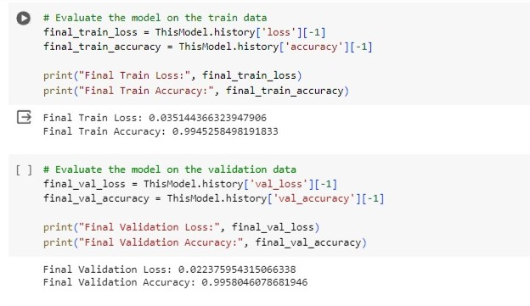
Evaluation
1
2
33

Slide 34
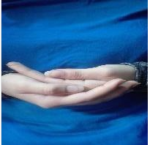
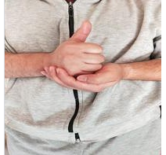
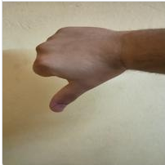
ASL_and_Words
34

Slide 35
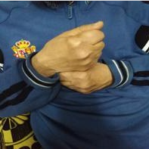
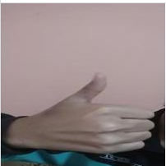
The dataset is About:
The dataset is a collection of images of Letters (a, b, c, …, z), Words (Help, Like, Brother, Baby, …) and Numbers (1, 2, 3, …, 9) from the American Sign Language, separated 203000 images in 51 folders, folder have 4,000 image, Common images in data sets are 200 x 200 pixels, and there are images 100 x 100 and other images that differ in their dimensions. which represent the various classes.
35

Slide 36
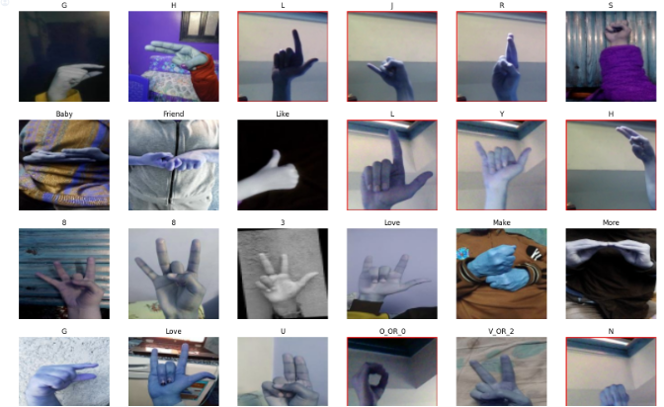
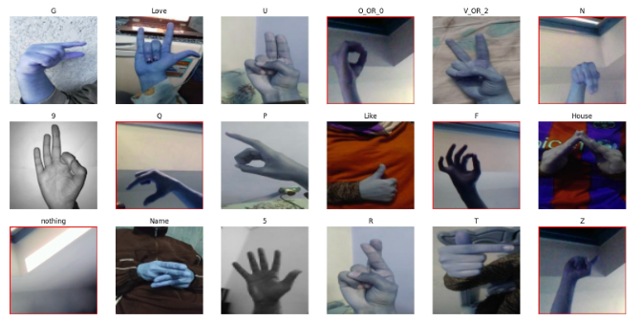
Samples from the dataset
36

Slide 37
Split Dataset
X_Train
Test
X-validation
203000 items
51 items
Y_Train
Split=20:80%
shuffle=True, random_state=100
y-validation
203000 items
37

Slide 38
Preprocessing
Resizing (64*64)
38

Slide 39
Create a CNN model on the Dataset
Layer type | Layer type Description | Size
Input Layer Conv 1 Conv 2 Conv 3 Conv 4 | Input Image Convolutional ReLU MaxPooling Convolutional ReLU MaxPooling Convolutional ReLU MaxPooling Convolutional ReLU MaxPooling | 3×64×64 32 kernel, 3x3 Window size 2×2 64 kernel, 5x5 Window size 2×2 128 kernel, 5x5 Window size 2×2 256 kernel, 3x3 Window size 2×2
39

Slide 40
Layer type | Layer type Description | Size
Flatten Fully Connected Layer1 Fully Connected Layer2 Fully Connected Layer3 Output Layer | Flatten Dense ReLU Dense ReLU Dense ReLU Dense SoftMax | 512 256 128 51
40

Slide 41
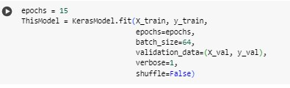
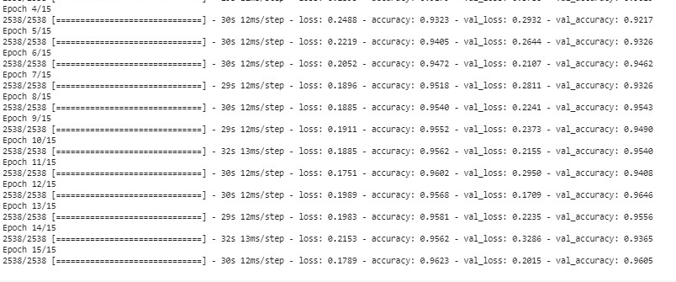
Epochs’ Number
1
2
41

Slide 42
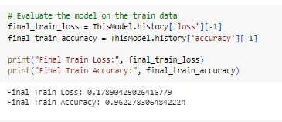
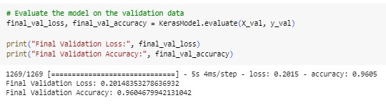
Evaluation
1
2
42

Slide 43
PreTrain Model: Split Dataset
X_Train
Test
X-validation
87000 items
28 items
Y_Train
Split=10:90%
shuffle=True, random_state=13
Y-validation
87000 items
43

Slide 44
Preprocessing
Resizing (200*200)
Augmentation
44

Slide 45
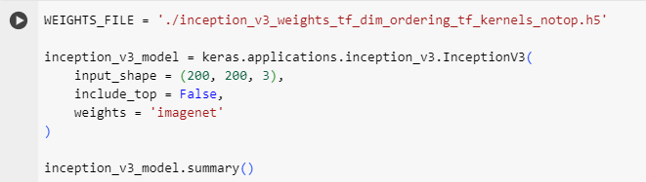
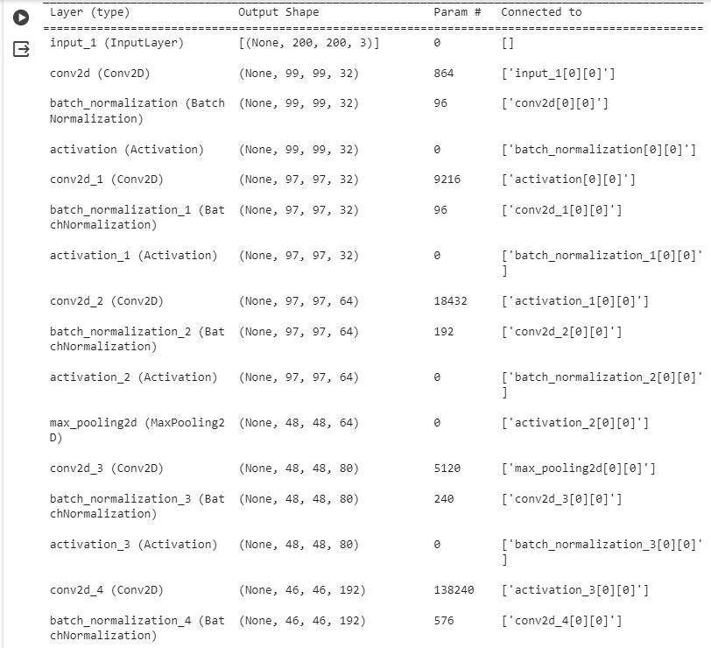
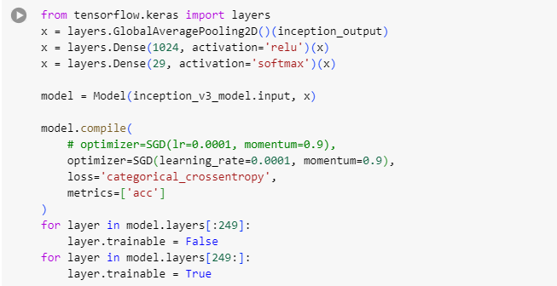
Pre Train Model
Name
The Model
The Model
45

Slide 46
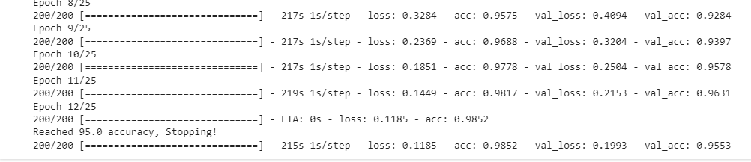
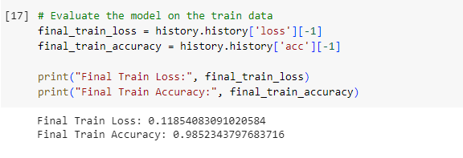
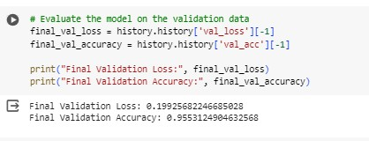
Pre Train Model
Epochs
Accuracy
Accuracy
46

Slide 47
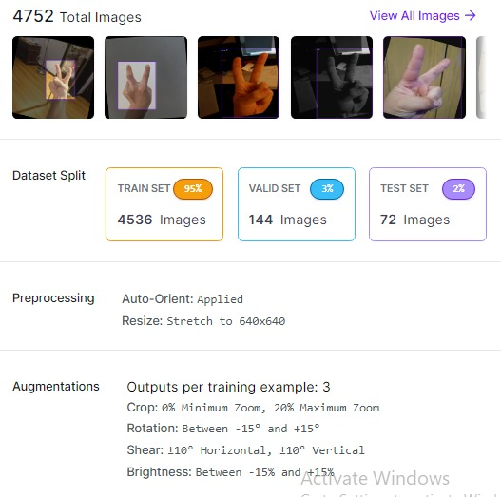


Roboflow
Detaille of data
V1 of data
Annotations
47

Slide 48



Roboflow
Train
Test
Valid
48

Slide 49
Yolov8 Preprocessing
Resizing (640*640)
Augmentation
49

Slide 50
Yolov8 Model: Split Dataset
Train
87%
Test
4%
Validation
8%
50

Slide 51


Yolov8 Model
Name
The Model
51

Slide 52

Yolov8 Model
train
Epochs
Accuracy
52

Slide 53
Yolov8 Model
validation
Test
53

Slide 54






05
Prototype, Tools, and Technologies + Framework
54

Slide 55

This is the SignTalk application.
A new application designed to bridge the communication gap between the deaf and hearing communities.
Many deaf and hard of hearing individuals face barriers due to their inability to hear.
SignTalk aims to break down these barriers through real-time sign language translation.
55

Slide 56






56

Slide 57





57

Slide 58





58

Slide 59



Sign Talk
59

Slide 60

Mobile App
Framework
Dart
Language
Tool
Flutter
Figma
60

Slide 61
Deep Learning
Framework
Python
Language
Model
Google Colab
CNN – Yollo v8
61

Slide 62
06
Project Scope
62

Slide 63
Dependances
Planning and organization
Effective communication
Dataset
Algorithm is suitable
Evaluation
63

Slide 64
Risk and Mitigation
We collected a set of data from 4 different languages, this data was studied, and then we began to choose the language most commonly spoken among people.
The user have more than one language for the deaf.
It is possible that the user will choose a word that is not found in the data set.
We combined two data sets.
It is possible that the user may not be proficient in writing to communicate with a deaf person.
Therefore, we added a microphone that converts speech into written text, making communication faster and easier.
64

Slide 65
Project developments
01
02
03
04
1- We will enhance the application for faster and easier communication by converting speech into sign language, enabling deaf individuals to understand. This makes the application bidirectional.
We will add a dataset containing sentences and more phrases to cover a larger portion of the language.
we will convert text into sign language as well.
We will incorporate multiple languages, allowing any user to use the application in any country and serve a broader audience.
65

Slide 66

07
Conclusion
66

Slide 67



Using deep learning, we created a model that recognizes hand gestures in sign language and translates them into expressive texts that express their needs and facilitate communication. This is done using convolutional neural networks that are trained on a set of properly labeled data and tested to reach the highest accuracy of the model.
We linked the model to a mobile phone to help them communicate in daily life.
67

Slide 68

Demo
68

Slide 69
Time Plan
Notes | Activity | Month
AI - Flutter | Study Courses | Jul - Aug - Sep
Search of Paper. Search of dataset and dataset Processing. Build Model (alphabet) and (Numbers). Making protoype in figma. Making home page and nav between all pages. | Paper Dataset Model Flutter | Oct - Nov
Build Model (Words). Model prediction and Pre train model. Making login and signup page in add to link it with firebase and making the documentation. Making a video to explain the app. | Model Flutter | Dec - Jan
Build Model object detection (image) (video) Making Convert from voice to text | Model Flutter | Feb - mar
Connect the model to the mobile app Make Book | Flutter | April - may
69

Slide 70
References
[1].Alphapet_Dataset
[1]English
https://www.kaggle.com/datasets/lexset/synthetic-asl-alphabet/data,”
https://www.kaggle.com/datasets/debashishsau/aslamerican-sign-language-aplhabet-dataset
https://www.kaggle.com/datasets/datamunge/sign-language-mnist/data
https://www.kaggle.com/datasets/grassknoted/asl-alphabet/code
[2]Arabic
https://www.kaggle.com/datasets/sabribelmadoui/arabic-sign-language-unaugmented-dataset
https://universe.roboflow.com/omdena-pemas/arabic-sl
[3]Spanish
https://www.kaggle.com/datasets/kirlelea/spanish-sign-language-alphabet-static”
[4]india
https://universe.roboflow.com/niladri-basu-roy-qnrm4/indian-sign-language-detection
https://www.kaggle.com/datasets/kartik2112/indian-sign-language-translation-letters-n-digits
https://www.kaggle.com/datasets/dodiyaparth/indian-sign-language
[2].Word_Dataset
[1]English
“https://www.kaggle.com/datasets/risangbaskoro/wlasl-processed,”
https://www.kaggle.com/datasets/kshitij192/action-recognition
https://www.kaggle.com/datasets/belalelwikel/asl-and-some-words/data
[2]Arabic
https://universe.roboflow.com/rania-hamada-xcozs/arabic-sign-language-words-detection
https://www.kaggle.com/datasets/mahmoudmsaafan/arabic-sign-language-dataset
70

Slide 71
[3]Spanish
https://www.kaggle.com/datasets/mguiralc03/spanishsignlanguagerecognitiontfg”
[4]india
https://www.kaggle.com/datasets/kshitij192/action-recognition
https://www.kaggle.com/datasets/daskoushik/include
https://www.kaggle.com/datasets/soumyakushwaha/indian-sign-language-dataset
[1].Sentence_Dataset
[1]English
“https://www.kaggle.com/datasets/tasinalnahiankhan/phrase-level-asl-converted-in-numpy-array,”
[2]Arabic
https://www.kaggle.com/datasets/mohamedlotfy50/arabic-sign-language
[4]india
https://data.mendeley.com/datasets/kcmpdxky7p/1
Paper_Link
https://sci-hub.se/10.1109/sti47673.2019.9067974
https://sci-hub.se/10.1109/iciccs51141.2021.9432296
https://link.springer.com/chapter/10.1007/978-981-15-7961-5_6
https://www.hindawi.com/journals/cin/2022/1450822/
https://link.springer.com/chapter/10.1007/978-981-99-3734-9_32
https://ieeexplore.ieee.org/abstract/document/9491897
https://www.sciencedirect.com/science/article/pii/S1877050922021846/pdf?
https://scholarworks.calstate.edu/downloads/dj52wb92k
https://sci-hub.se/https://ieeexplore.ieee.org/abstract/document/9179356/
https://www.hindawi.com/journals/wcmc/2020/3685614/
71

Slide 72

Thanks!
72

